Slide 1

IBM Applied Data Science Capstone Coursera Capstone
Opening a New Restaurant in Manhattan, NYC
By: Boyin Zhu, April 2020

Slide 2
Business Problem : Location of the Restaurant is one of the most important decisions that will determine whether the restaurant will be a success or a failure Objective: To analyze and select the best locations in Manhattan, NYC to open a new restaurant. Business question : In Manhattan, NYC if a restaurant owner is looking to open a new restaurant, where would you recommend that they open it?
- Business Problem & Business question

Slide 3
Data •Data required 1. List of neighborhoods in Manhattan 2. Latitude and longitude coordinates of the neighborhoods 3. Venue data, particularly data related to shopping malls •Sources of data 1. Wikipedia page for neighborhoods (https://en.wikipedia.org/wiki/List_of_Manhattan_neighborhoods) 2. Geocoder package for latitude and longitude coordinates 3. Foursquare API for venue data
- Sources of data

Slide 4
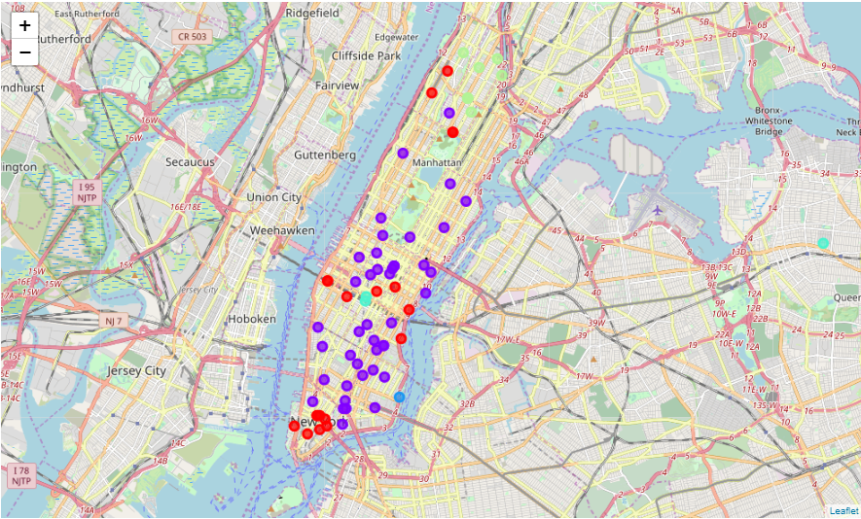
Results •Categorized the neighborhoods into 6 clusters : 1. Cluster 1: Neighborhoods with coffee shops and mainly in downtown and mid-town 2. Cluster 2: Neighborhoods with concentrated restaurants 3. Cluster 4: Neighborhoods with Korean restaurants 4. Cluster 5: Neighborhoods with low numbers of restaurant mainly in upper town 5. Cluster 3&6 only contains 1 area and are excluded
- Results

Slide 5
Discussion •Most of the restaurants are concentrated in the downtown and mid-town of the city •Highest number in cluster 2 and moderate number in cluster 4 •Cluster 1 has very low number of the restaurants in the neighborhoods •High concentration of Korean Food in Cluster 4
- Discussion

Slide 6
Recommendations
There will be less competition to choose the cluster 1 (red spots) to launch a new restaurant in a busy neighborhood or to choose cluster 5 to launch one in a less commercial area
There will be more competition to launch restaurants in cluster 2 (Purple spots).
However, it will be a good choice to open a new restaurant in cluster 4 (light blue spots) if the owner wants to open a Korean restaurant where will promise the customers’ volume
- Recommendations

Slide 7
Conclusion •Answer to business question: The neighborhoods in cluster 1 are the most preferred locations to open a new restaurant •Findings of this project will help the relevant stakeholders to capitalize on the opportunities on high potential locations while avoiding overcrowded areas in their decisions to open a restaurant
- Conclusion

